Slide 1
Gate-Level Minimization
Prepared by Dr. Sultan S. Alqahtani
CS106 Digital Logic

Slide 2
Content
Karnaugh Map (K-Map)
Two variable
Three variable
Four variable
Rules of 1’s grouping
Simplify Boolean Expressions with K-Map
Product of Sums Simplification
Don’t-Care Conditions
NAND and NOR Implementations

Slide 3
What is a Karnaugh Map?
Special form of a truth table which enables easier pattern recognition
Pictorial method of simplifying Boolean expressions
Good for circuits designs with up to 4 variables.

Slide 4
Truth Table
OR
A | B | F
0 | 0 | 0
0 | 1 | 1
1 | 0 | 1
1 | 1 | 1

Slide 5
Karnaugh Map
OR
A
A | B | F
0 | 0 | 0
0 | 1 | 1
1 | 0 | 1
1 | 1 | 1
0
1
B
0
1
F

Slide 6
Karnaugh Map
OR
A
A | B | F
0 | 0 | 0
0 | 1 | 1
1 | 0 | 1
1 | 1 | 1
0
1
B
0
0
1
F

Slide 7
Karnaugh Map
OR
A
A | B | F
0 | 0 | 0
0 | 1 | 1
1 | 0 | 1
1 | 1 | 1
0
1
B
0
0
1
1
F

Slide 8
Karnaugh Map
OR
A
A | B | F
0 | 0 | 0
0 | 1 | 1
1 | 0 | 1
1 | 1 | 1
0
1
B
0
1
0
1
1
F

Slide 9
Karnaugh Map
OR
A
A | B | F
0 | 0 | 0
0 | 1 | 1
1 | 0 | 1
1 | 1 | 1
0
1
B
0
1
0
1
1
1
F

Slide 10
Karnaugh Map
OR
A
A | B | F
0 | 0 | 0
0 | 1 | 1
1 | 0 | 1
1 | 1 | 1
0
1
B
0
1
0
1
1
1
F

Slide 11
Deriving Expressions from a Karnaugh Map

Slide 12
Karnaugh Map
A
A | B | F
0 | 0 | 0
0 | 1 | 0
1 | 0 | 1
1 | 1 | 1
0
1
B
0
1
0
1
0
1
F =
A

Slide 13
Karnaugh Map
A
A | B | F
0 | 0 | 0
0 | 1 | 1
1 | 0 | 1
1 | 1 | 1
0
1
B
0
1
0
1
1
1
F =
A + B

Slide 14
Karnaugh Map
A
A | B | F
0 | 0 | 1
0 | 1 | 1
1 | 0 | 1
1 | 1 | 1
0
1
B
1
1
0
1
1
1
F =
1

Slide 15
Karnaugh Map
A
A | B | F
0 | 0 | 1
0 | 1 | 1
1 | 0 | 1
1 | 1 | 0
0
1
B
1
1
0
1
1
0
F =
A’ + B’

Slide 16
Karnaugh Maps with 3 Variables

Slide 17
A | B | C | F
0 | 0 | 0 | 0
0 | 0 | 1 | 0
0 | 1 | 0 | 1
0 | 1 | 1 | 1
1 | 0 | 0 | 1
1 | 0 | 1 | 1
1 | 1 | 0 | 1
1 | 1 | 1 | 1
Karnaugh Map
A
BC
0
1
00
01
11
10

Slide 18
A | B | C | F
0 | 0 | 0 | 0
0 | 0 | 1 | 0
0 | 1 | 0 | 1
0 | 1 | 1 | 1
1 | 0 | 0 | 1
1 | 0 | 1 | 1
1 | 1 | 0 | 1
1 | 1 | 1 | 1
Karnaugh Map
A
BC
0
1
00
0
01
11
10

Slide 19
A | B | C | F
0 | 0 | 0 | 0
0 | 0 | 1 | 0
0 | 1 | 0 | 1
0 | 1 | 1 | 1
1 | 0 | 0 | 1
1 | 0 | 1 | 1
1 | 1 | 0 | 1
1 | 1 | 1 | 1
Karnaugh Map
A
BC
0
1
00
0
01
0
11
10

Slide 20
A | B | C | F
0 | 0 | 0 | 0
0 | 0 | 1 | 0
0 | 1 | 0 | 1
0 | 1 | 1 | 1
1 | 0 | 0 | 1
1 | 0 | 1 | 1
1 | 1 | 0 | 1
1 | 1 | 1 | 1
Karnaugh Map
A
BC
0
1
00
0
01
0
11
10
1

Slide 21
A | B | C | F
0 | 0 | 0 | 0
0 | 0 | 1 | 0
0 | 1 | 0 | 1
0 | 1 | 1 | 1
1 | 0 | 0 | 1
1 | 0 | 1 | 1
1 | 1 | 0 | 1
1 | 1 | 1 | 1
Karnaugh Map
A
BC
0
1
00
0
01
0
11
1
10
1

Slide 22
A | B | C | F
0 | 0 | 0 | 0
0 | 0 | 1 | 0
0 | 1 | 0 | 1
0 | 1 | 1 | 1
1 | 0 | 0 | 1
1 | 0 | 1 | 1
1 | 1 | 0 | 1
1 | 1 | 1 | 1
Karnaugh Map
A
BC
0
1
00
0
1
01
0
11
1
10
1

Slide 23
A | B | C | F
0 | 0 | 0 | 0
0 | 0 | 1 | 0
0 | 1 | 0 | 1
0 | 1 | 1 | 1
1 | 0 | 0 | 1
1 | 0 | 1 | 1
1 | 1 | 0 | 1
1 | 1 | 1 | 1
Karnaugh Map
A
BC
0
1
00
0
1
01
0
1
11
1
10
1

Slide 24
A | B | C | F
0 | 0 | 0 | 0
0 | 0 | 1 | 0
0 | 1 | 0 | 1
0 | 1 | 1 | 1
1 | 0 | 0 | 1
1 | 0 | 1 | 1
1 | 1 | 0 | 1
1 | 1 | 1 | 1
Karnaugh Map
A
BC
0
1
00
0
1
01
0
1
11
1
10
1
1

Slide 25
A | B | C | F
0 | 0 | 0 | 0
0 | 0 | 1 | 0
0 | 1 | 0 | 1
0 | 1 | 1 | 1
1 | 0 | 0 | 1
1 | 0 | 1 | 1
1 | 1 | 0 | 1
1 | 1 | 1 | 1
Karnaugh Map
A
BC
0
1
00
0
1
01
0
1
11
1
1
10
1
1

Slide 26
A | B | C | F
0 | 0 | 0 | 0
0 | 0 | 1 | 0
0 | 1 | 0 | 1
0 | 1 | 1 | 1
1 | 0 | 0 | 1
1 | 0 | 1 | 1
1 | 1 | 0 | 1
1 | 1 | 1 | 1
Karnaugh Map
A
BC
0
1
00
0
1
F =
A + B
01
0
1
11
1
1
10
1
1

Slide 27
F =
A + B
A
BC
0
1
AB
00
01
11
10
0
1
C
00
0
0
1
1
1
01
0
1
1
0
1
1
1
11
1
1
10
1
1

Slide 28
F =
AB
C
00
01
11
10
0
0
1
1
1
1
0
1
1
1
Wrong☹

Slide 29
F =
AB
C
00
01
11
10
0
0
1
1
1
1
0
1
1
1
Correct☺

Slide 30
F =
A + B
AB
C
00
01
11
10
0
0
1
1
1
1
0
1
1
1

Slide 31
F =
A + B
AB
C
00
01
11
10
0
0
1
1
1
1
0
1
1
1

Slide 32
F =
A + B
AB
C
00
01
11
10
0
0
1
1
1
1
0
1
1
1
We would still arrive to the same conclusion. That this K-map represents the expression: B+A. But it is always best to create groups as large as possible

Slide 33
A | B | C | F
0 | 0 | 0 | 1
0 | 0 | 1 | 0
0 | 1 | 0 | 1
0 | 1 | 1 | 0
1 | 0 | 0 | 1
1 | 0 | 1 | 1
1 | 1 | 0 | 1
1 | 1 | 1 | 1
F =
C’ + A
AB
C
00
01
11
10
0
1
1
1
1
1
0
0
1
1

Slide 34
F =
A.B
AB
C
00
01
11
10
0
0
0
1
0
1
0
0
1
0

Slide 35
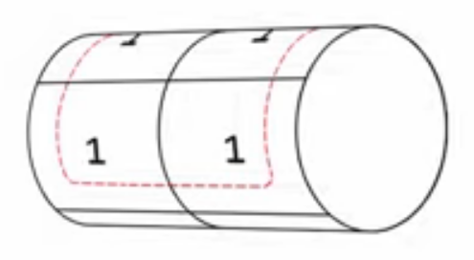
F =
C’
A
BC
0
1
00
1
1
01
0
0
11
0
0
10
1
1

Slide 36
F =
AC’
A
BC
0
1
00
0
1
01
0
0
11
0
0
10
0
1

Slide 37
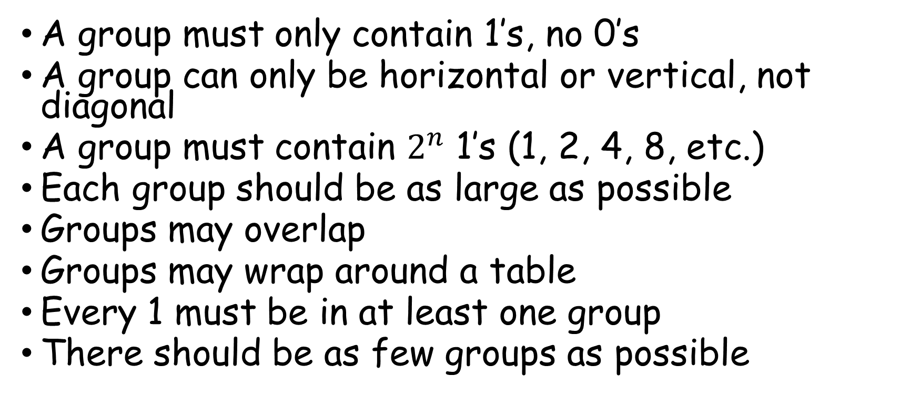
Summary of Grouping Rules
A group must only contain 1’s, no 0’s
A group can only be horizontal or vertical, not diagonal
A group must contain $2^{n}$ 1’s (1, 2, 4, 8, etc.)
Each group should be as large as possible
Groups may overlap
Groups may wrap around a table
Every 1 must be in at least one group
There should be as few groups as possible

Slide 38
Karnaugh Maps with 4 Variables

Slide 39
A | B | C | D | F
0 | 0 | 0 | 0 | 0
0 | 0 | 0 | 1 | 1
0 | 0 | 1 | 0 | 0
0 | 0 | 1 | 1 | 0
0 | 1 | 0 | 0 | 0
0 | 1 | 0 | 1 | 1
0 | 1 | 1 | 0 | 0
0 | 1 | 1 | 1 | 0
1 | 0 | 0 | 0 | 0
1 | 0 | 0 | 1 | 1
1 | 0 | 1 | 0 | 0
1 | 0 | 1 | 1 | 0
1 | 1 | 0 | 0 | 1
1 | 1 | 0 | 1 | 1
1 | 1 | 1 | 0 | 1
1 | 1 | 1 | 1 | 1
Karnaugh Map
AB
CD
00
01
11
10
00
0
0
1
0
01
1
1
1
1
11
0
0
1
0
10
0
0
1
0

Slide 40
A | B | C | D | F
0 | 0 | 0 | 0 | 0
0 | 0 | 0 | 1 | 1
0 | 0 | 1 | 0 | 0
0 | 0 | 1 | 1 | 0
0 | 1 | 0 | 0 | 0
0 | 1 | 0 | 1 | 1
0 | 1 | 1 | 0 | 0
0 | 1 | 1 | 1 | 0
1 | 0 | 0 | 0 | 0
1 | 0 | 0 | 1 | 1
1 | 0 | 1 | 0 | 0
1 | 0 | 1 | 1 | 0
1 | 1 | 0 | 0 | 1
1 | 1 | 0 | 1 | 1
1 | 1 | 1 | 0 | 1
1 | 1 | 1 | 1 | 1
Karnaugh Map
AB
CD
00
01
11
10
00
0
0
1
0
F = A.B + C’.D
01
1
1
1
1
11
0
0
1
0
10
0
0
1
0

Slide 41
F =A.D’ + A’.C’.D
AB
CD
00
01
11
10
00
0
0
1
1
01
1
1
0
0
11
0
0
0
0
10
0
0
1
1

Slide 42
F = A’ + B + D’
AB
CD
00
01
11
10
00
1
1
1
1
01
1
1
1
0
11
1
1
1
0
10
1
1
1
1

Slide 43
Simplify Boolean Expressions with Karnaugh Maps

Slide 44
F =A’.B + B.C’ + B.C + A.B’.C’
F =B +A.C’
AB
C
00
01
11
10
0
1
1
1
1
1
1
1
1
1
1
1
1

Slide 45
A | B | C | F
0 | 0 | 0
0 | 0 | 1
0 | 1 | 0
0 | 1 | 1
1 | 0 | 0
1 | 0 | 1
1 | 1 | 0
1 | 1 | 1
F =
A.B + A.C + B.C’ + A.B.C’
AB
C
00
01
11
10
0
1

Slide 46
A | B | C | F
0 | 0 | 0
0 | 0 | 1
0 | 1 | 0
0 | 1 | 1
1 | 0 | 0
1 | 0 | 1
1 | 1 | 0
1 | 1 | 1
F =
A.B + A.C + B.C’ + A.B.C’
AB
C
00
01
11
10
0
1
1
1

Slide 47
A | B | C | F
0 | 0 | 0
0 | 0 | 1
0 | 1 | 0
0 | 1 | 1
1 | 0 | 0
1 | 0 | 1
1 | 1 | 0
1 | 1 | 1
F =
A.B + A.C + B.C’ + A.B.C’
AB
C
00
01
11
10
0
1
1
1
1

Slide 48
A | B | C | F
0 | 0 | 0
0 | 0 | 1
0 | 1 | 0 | 1
0 | 1 | 1
1 | 0 | 0
1 | 0 | 1
1 | 1 | 0
1 | 1 | 1
F =
A.B + A.C + B.C’ + A.B.C’
AB
C
00
01
11
10
0
1
1
1
1

Slide 49
A | B | C | F
0 | 0 | 0
0 | 0 | 1
0 | 1 | 0 | 1
0 | 1 | 1
1 | 0 | 0
1 | 0 | 1
1 | 1 | 0
1 | 1 | 1
F =
A.B + A.C + B.C’ + A.B.C’
AB
C
00
01
11
10
0
1
1
1
1

Slide 50
A | B | C | F
0 | 0 | 0 | 0
0 | 0 | 1 | 0
0 | 1 | 0 | 1
0 | 1 | 1 | 0
1 | 0 | 0 | 0
1 | 0 | 1
1 | 1 | 0
1 | 1 | 1
F =
A.B + A.C + B.C’ + A.B.C’
AB
C
00
01
11
10
0
1
1
1
1
1
1
1
F = B.C’ + A.C
1

Slide 51
A | B | C | D | F
0 | 0 | 0 | 0
0 | 0 | 0 | 1
0 | 0 | 1 | 0
0 | 0 | 1 | 1
0 | 1 | 0 | 0
0 | 1 | 0 | 1
0 | 1 | 1 | 0
0 | 1 | 1 | 1
1 | 0 | 0 | 0
1 | 0 | 0 | 1
1 | 0 | 1 | 0
1 | 0 | 1 | 1
1 | 1 | 0 | 0
1 | 1 | 0 | 1
1 | 1 | 1 | 0
1 | 1 | 1 | 1
F = A’.B.C’.D + A’.B.C.D + A.B.C’.D + B.C.D
AB
CD
00
01
11
10
QUIZ ☹
00
01
11
10

Slide 52
A | B | C | D | F
0 | 0 | 0 | 0 | 0
0 | 0 | 0 | 1 | 0
0 | 0 | 1 | 0 | 0
0 | 0 | 1 | 1 | 0
0 | 1 | 0 | 0 | 0
0 | 1 | 0 | 1 | 1
0 | 1 | 1 | 0 | 0
0 | 1 | 1 | 1 | 1
1 | 0 | 0 | 0 | 0
1 | 0 | 0 | 1 | 0
1 | 0 | 1 | 0 | 0
1 | 0 | 1 | 1 | 0
1 | 1 | 0 | 0 | 0
1 | 1 | 0 | 1 | 1
1 | 1 | 1 | 0 | 0
1 | 1 | 1 | 1 | 1
F = A’.B.C’.D + A’.B.C.D + A.B.C’.D + B.C.D
F = B.D
AB
CD
00
01
11
10
Results☺
00
0
0
0
0
01
0
1
1
0
11
0
1
1
0
10
0
0
0
0

Slide 53
Product of Sums Simplification
Remember, all the minimized Boolean functions from the maps in all previous examples in the lectures were expressed in sum of products (SOP) form.
With a minor modifications, the product of sums can be obtained.

Slide 54
Product of Sums Simplification
The 1’s placed in the squares of the map represent the minterms of the function F.
The 0’s represent the minterms of the complement of the function, i.e., F’
The complement of F’ is the original function F= (F’)’ -> by Involution.
Because of the generalized DeMorgan’s theorem, the function so obtained is automatically in the product of sum form.

Slide 55
Product of Sums Simplification
Step 1: Find F’ in a sum of product form (simply group and express 0’s in product terms)
Ste 2: Find (F’)’ = F by applying De Morgan’s Law, which will automatically convert the expression in product of sum form.

Slide 56
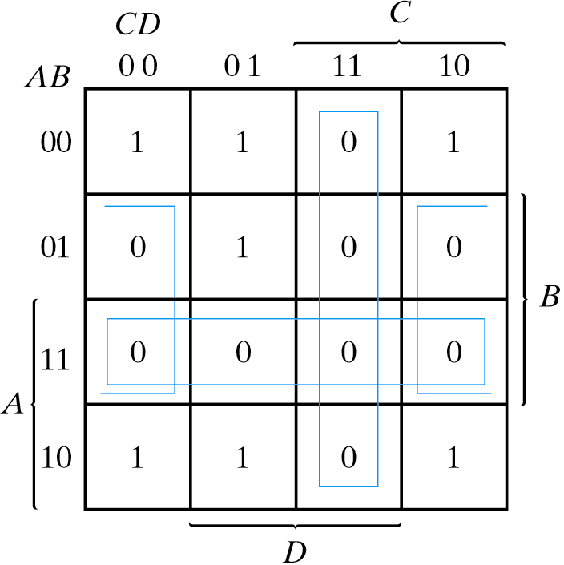
Example
Simplify the Boolean function in (a) sum of products and (b) product of sums F(A,B,C,D)=Σ(0,1,2,5,8,9,10)

Slide 57
Example
Sum of products F = B’D’ + B’C’ + A’C’D
Product of sums F’ = AB + CD + BD’
Apply DeMorgan’s Theorem, we get F = (A’+B’)(C’+D’)(B’+D)

Slide 58
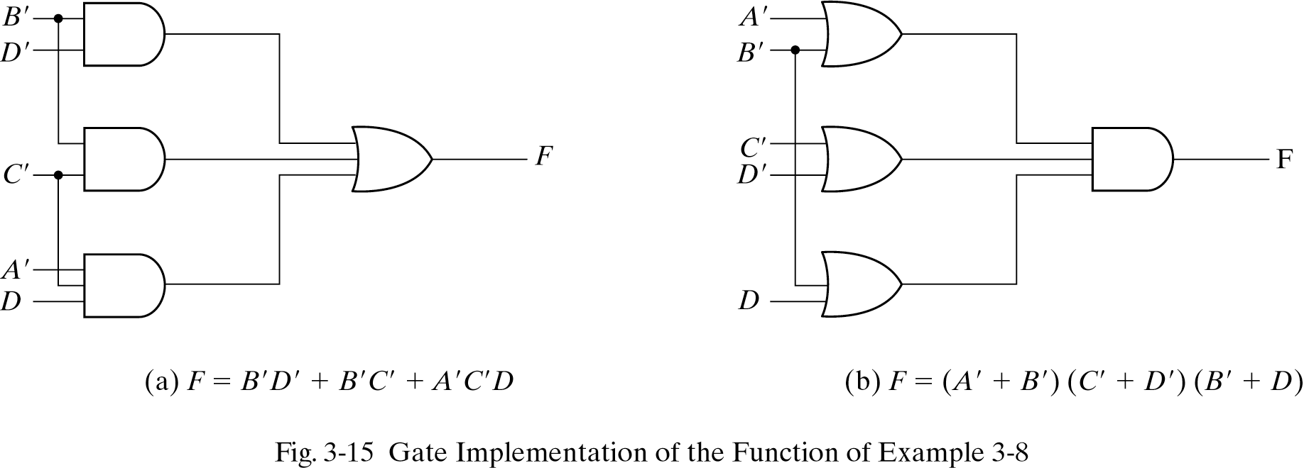
Gate Implementation

Slide 59
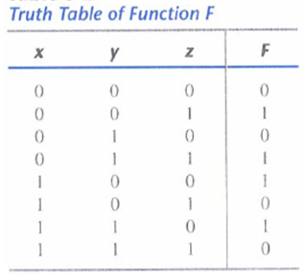
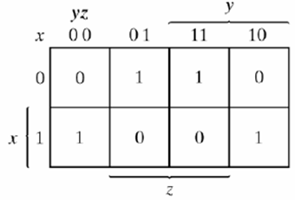
Example
Example expressed in Canonical forms
F( x, y, z) = Σ(1, 3, 4, 6) = Π(0, 2, 5, 7)
F = x'z +xz‘ (sum of product, 1s)
F' = xz +x'z‘ (0’, apply DeMorgan's theorem) we get F = (x'+z’)(x + z) (product of sum)

Slide 60
Example
Simplify the Boolean function F(A,B,C,D) = ∑(1,3,4,5,6,12,13,14) in both sum of products and product of sums form.
HW ☺

Slide 61
Don’t-Care Conditions
In practice, there are applications where the function is not specified for certain combinations of the input variables. For example, in the 4-bit BCD code for the decimal digits, the outputs are unspecified for the input combinations 1010-1111.
Functions that have unspecified outputs for some input combinations are called incompletely specified functions.
The unspecified minterms of a function are called the don’t-care conditions, or simply the don’t-cares, and are denoted as X’s.

Slide 62
Example
These don’t-care conditions can be used on a map to provide further simplification of the Boolean expression.
Each X can be assigned an arbitrary value, 0 or 1, to help the simplification procedure.
Simplify the Boolean function
F(w, x, y, z) = Σ(1, 3, 7, 11, 15) that has the don’t-care conditions
d (w, x, y, z) = Σ(0, 2, 5).

Slide 63
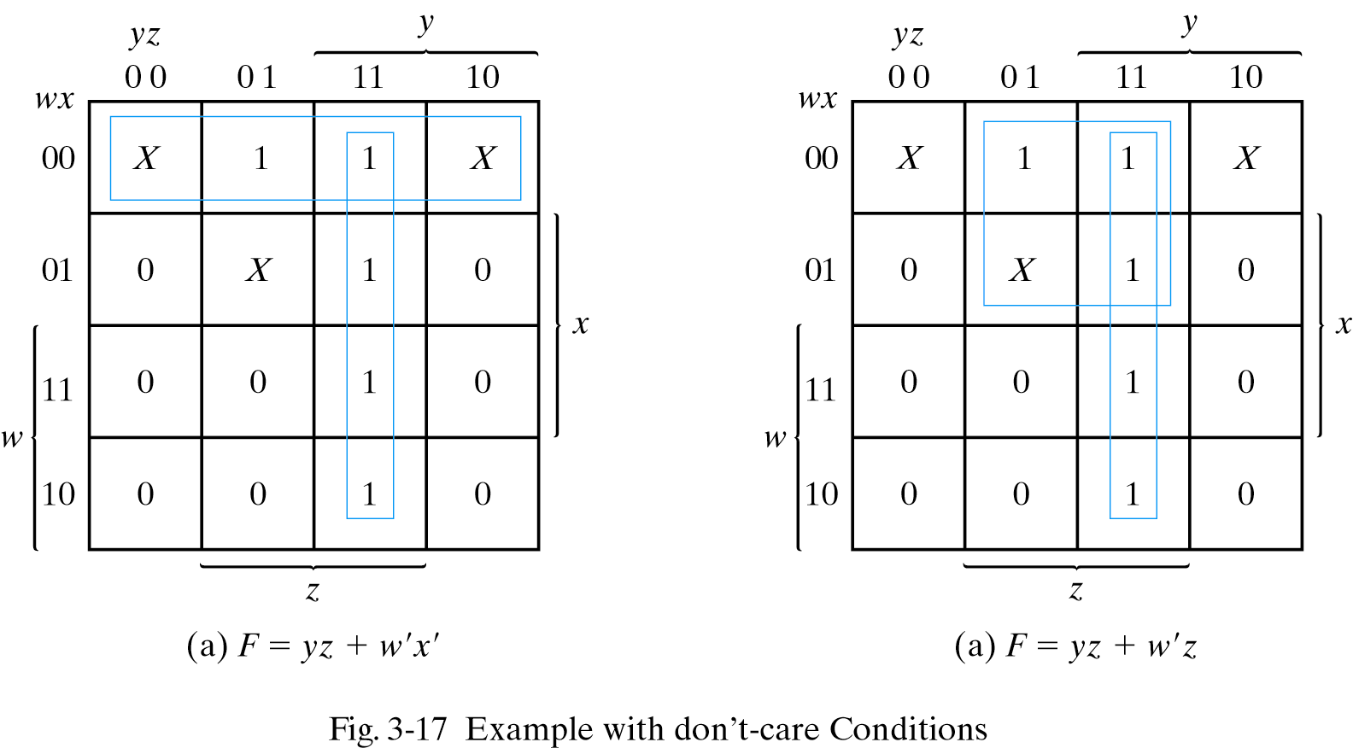
Example
F(w, x, y, z) = yz + w'x' = Σ(0, 1, 2, 3, 7, 11, 15)
F(w, x, y, z) = yz + w'z = Σ(1, 3, 5, 7, 11, 15)

Slide 64
NAND & NOR Implementation
Digital circuits are more frequently constructed with NAND/NOR gates than with AND/OR gates due to ease of fabrication.
Name Symbol Function Truth Table
A B X
NAND
A
X X = (AB)’
B
0 0 1
0 1 1
1 0 1
1 1 0
A
X X = (A + B)’
B
A B X
NOR
0 0 1
0 1 0
1 0 0
1 1 0
XOR
Exclusive OR
A X = A ⊕ B
X or
B X = A’B + AB’
A B X
0 0 0
0 1 1
1 0 1
1 1 0
XNOR
A X = (A ⊕ B)’
X or
B X = A’B’+ AB
A B X
0 0 1
0 1 0
1 0 0
1 1 1
Exclusive NOR
or Equivalence

Slide 65
NAND
The NAND gate is said to be a universal gate because any digital system can be implemented with it.
For example, operations of AND, OR and NOT can be obtained with NAND gate only
A one-input NAND gate behaves like an inverter.
The AND operation requires two NAND gates – the first produces NAND operation and the second inverts the logical sense of the signal.
The OR operation is achieved through a NAND gate with additional inverters in each input.

Slide 66
NOR
NOR Operation is the Dual of the NAND
OR gates to NOR gates with NOR-invert
AND gates to NOR gates with invert-NOR
Any Inverter that is not compensated by another inverter along the same line needs an inverter or the complementation of the input literal

Slide 67
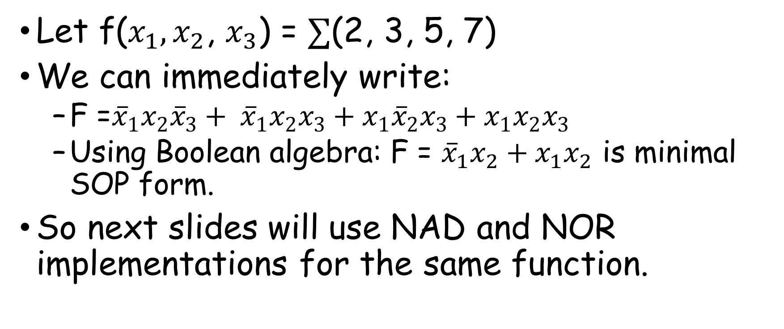
Example: NAND & NOR Implementation
Let f($x_{1},x_{2}$, $x_{3}$) = $∑$(2, 3, 5, 7)
We can immediately write:
F =${\overline{x}}_{1}x_{2}{\overline{x}}_{3}+ {\overline{x}}_{1}x_{2}x_{3}+x_{1}{\overline{x}}_{2}x_{3}+x_{1}x_{2}x_{3}$
Using Boolean algebra: F = ${\overline{x}}_{1}x_{2}+x_{1}x_{2}$ is minimal SOP form.
So next slides will use NAD and NOR implementations for the same function.
m2
m3
m5
m7

Slide 68
NAND gate implementation
From note

Slide 69
NOR gate Implementation, first attempt
From note

Slide 70
NOR gate Implementation, second attempt
From note

Slide 72
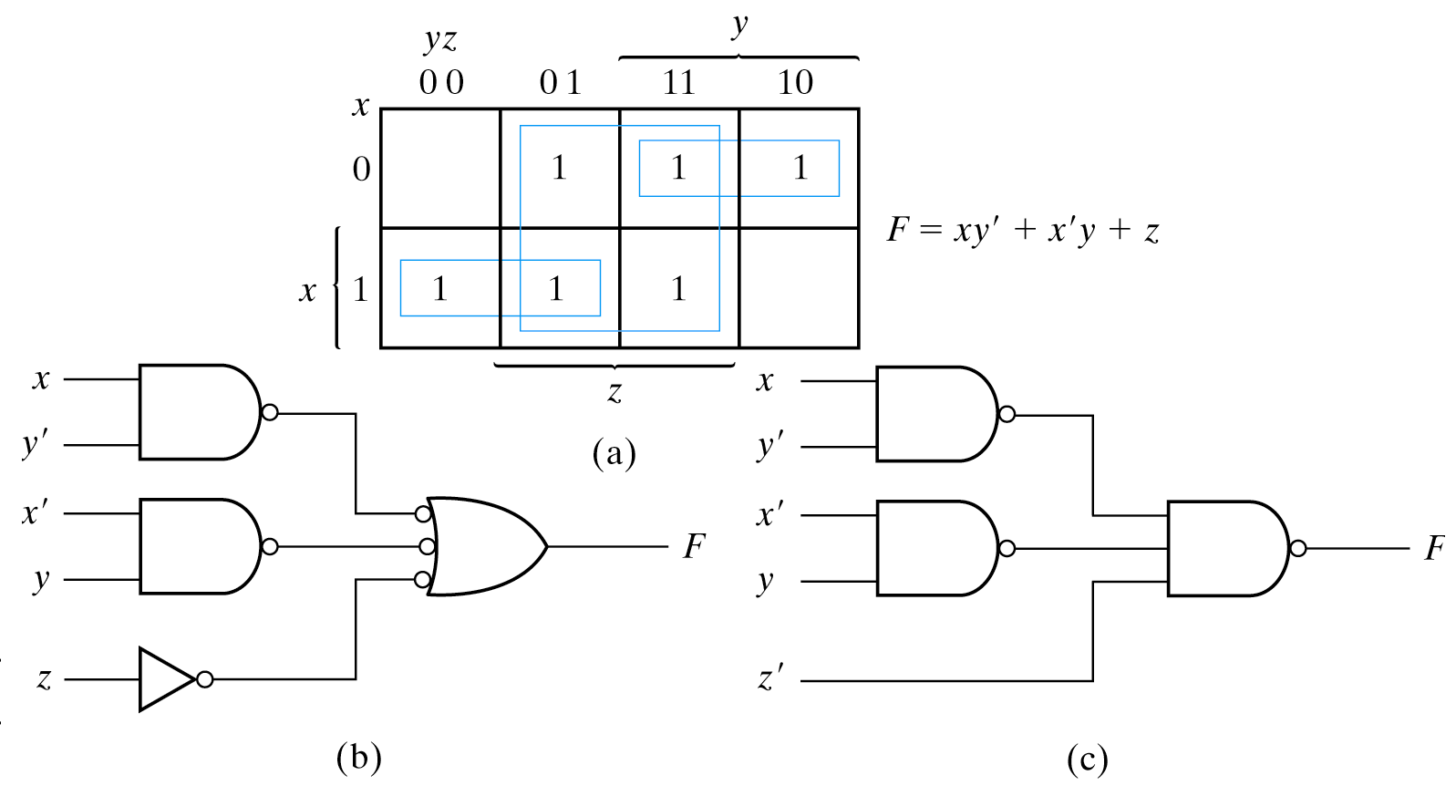
Example
Implement the following Boolean function with NAND gates F(x, y, z)=Σ(1, 2, 3, 4, 5, 7)

Slide 73
Conclusion
K-map used to simplify Boolean functions into minimal form of POS or SOP
NAND and NOR gates are universal gate representations.

